Slide 1
Who is the next ‘Jobs’ and ‘Apple’?
The awesome marketing strategy of YG & YG Entertainment
December 14. 2014 Youngsub Chun

Slide 2
YG Entertainment
(YGE) is a record label and talent agency founded by Yang Hyun-suk based in Seoul, South Korea. YG is an abbreviation for "Yang Goon", a nickname given to the Executive Director/Founder Yang Hyun-suk. Current roster of recording artists are known to be some of the biggest K-pop acts internationally, especially Big Bang, 2NE1, Epik High and Psy. (http://www.ygunited.com)

Slide 3
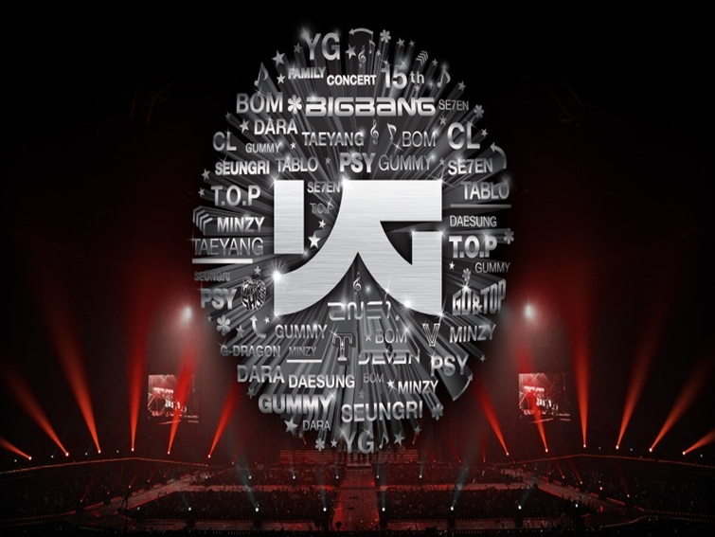

Slide 4
Gangnam Style"
“Gangnam Style” is the 18th K-pop single by the South Korean musician Psy. On December 21, 2012, "Gangnam Style" became the first YouTube video to reach one billion views. The song's music video has been viewed over 2.15 billion times on YouTube, and has been YouTube's most watched video since November 24, 2012. On December 1, 2014, YouTube announced that the song had broken the YouTube counter at 2,147,483,647 views, prompting the company to rewrite its software to handle larger numbers (http://www.youtube.com/watch?v=9bZkp7q19f0)

Slide 5
Hangover
The music video of “” released in June this year surpassed 100 million views around the world within one month from its release, and now, it is recording 164 million views. PSY and world-class hip-hop musician SnoopDogg’s comic acting stands out in the music video of “hangover” (http://www.youtube.com/watch?v=HkMNOlYcpHg)

Slide 6
YG Groups
“Fantastic baby” music video by ‘Bigbang (boys group)’ reached 100million views in 2014.( http://www.youtube.com/watch?v=AAbokV76tkU)
"I am the best "MV by ‘2NE1 (girls group)’ reached 100 million views in 2014 and the New Album (Crush) awarded the top 10 of Billboard’s World Albums Artists list. (http://www.youtube.com/watch?v=j7_lSP8Vc3o)
‘Epik High (Hip-hop group)'s latest MV“Born hater” provokes sensational reaction and reached 4 million views in only a month in 2014. (http://www.youtube.com/watch?v=3s1jaFDrp5M) (http://www.youtube.com/watch?v=vLbfv-AAyvQ)

Slide 7
YG Entertainment&Marketing 4.0
“2014 will be the most important for YGE than any other years. To put it roughly, this year is going to be a year of gamble that will determine the next 10 years of YGE.”-YG
YG Entertainment has showed how to activate effective marketing strategy to world market through customer-centric and surprising social media marketing.
This is the new version of marketing 3.0 or Marketing 4.0
“Marketing is not the art of finding clever ways to dispose of what you make. Marketing is the art of clever genuine customer value. It is the art of helping your customers become better off. The marketer’s watchwords are quality, service, and value.”- P.Kotler

Slide 8
‘Let it be’
‘Let it be’, to produce not a singer but a musician for competitive advantage
YGE’s core contents are professional singers and talented teenager groups. Like other music labels, YGE focus to develop and improve competitive musicians. Inside environment of YGE is a kind of cardinal jungle same as hunger game place. Every month, there is YGE audition for more than 1,000 candidates but just one or a few is chosen as a pre-trainee, moreover there is difficult inside assessment test for pre-trainee to survive with others every time.
Like famous ‘Ra Masia’ (youth football academy of FC Barcelona), YG academy recruits talented young candidates and educate them both music disciplinary and society life for long time.

Slide 9
The most important thing for all trainees is to find their own specialty and excellence to compete with other professional musicians. Without uniqueness and creativity, nobody can debut as a musician.
YGE’s main genre is hip-hop and R & B, but these are minor genre in music industry. Therefore, YGE asks for their singers to be attractive and independent musicians. YGE has top class producer and artistes in advanced management system so that relevant professional experts help trainees to reach high level of professionals, nonetheless their methodology and philosophy perfectly focus to guide them to be a real musician who creates own music and style.
As a result, almost of all singers of YGE have to be a real musician who can differentiate with others and set up his/her characteristic music.

Slide 10
‘Yesterday’
‘Yesterday’, positioning integrated brand value for long-term strategy
“Great brands are the only route to sustained, above-average profitability. And great brands present emotional benefits, not just rational benefit.” –P. Kotler
Without brand value and marketing of Michael Jordan and Tiger woods, Nike could not ‘just do it’ and be the world No.1 sport brand in sport industry.
Probably 80% of a company’s values lie in its intangible asset. Brand values of the company reproduce continuously their profitable contents in commercial and social environment.
In 2013, YGE’ revenue was about $ 80millions but brand value price will be 10 times higher than booked asset. YGE has produced competitive advantage in brand value and has created individual brand for musicians. Therefore one brand develops and multiplies its brand to diverse brand in lots of business.

Slide 11
‘Psy and Gangnam style’ are outstanding ‘YouTube’ icons of social media culture in global digital economy.
‘Bigbang & G-Drangon’ have the concrete brand powerin teenager music market and young culture of Asia.
‘2NE1 & Epik High’ also have creative and distinct brand value than any other musicians in their music department.
YG fans consider ‘YG Family and musician brand’ like that ‘freedom, youth, resistance, unique, passion, progress, soul, fun, exciting, fantasy, and smile’ etc.
YGE musicians call themselves as YG family, furthermore YG family by brand has very multiple and integrated brand positioning between fan and customer in music market. YG fans feel them one of them as an YG family and reproduce story-telling, interesting news, video and social media contents by themselves.
Because of this strong brand value, YGE can open Asia and world music market and YGE can cooperate with global brand companies.

Slide 12
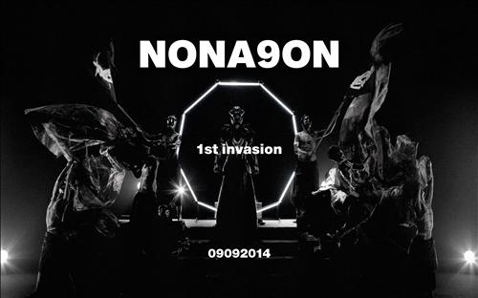
‘ I want to hold your hand’
‘ I want to hold your hand’, international marketing with global partners
A business level cooperative strategy is the one in which a number of firms work together to attain some common goal. There are different types of business level cooperative strategies like Joint Venture, Horizontal integration, vertical integration, Conglomerate diversification, etc.
A company that masters only its domestic market will eventually lose it. Strong foreign competitors will inevitably come in and challenge the company. One of the best growth paths for a business is to go regional or global.

Slide 13
For International marketing YGE aims to facilitate its growth and improves its brand position with global partners. YGE wants this cooperation to be global expansion of YG musicians and to be potential tie-ups in the world of fashion, cosmetics and integrated entertainment.
YGE’s objective for international marketing is to keep up its originality and creativity, furthermore produce strengthening brand value that will create a "wave" in not only Asia but all over the world.

Slide 14
‘All you need is love’
‘All you need is love’, how to activate social media marketing for YG family lovers
Social media has become ubiquitous and most important for social networking, content sharing and online accessing. Due to its reliability, consistency and instantaneous features, social media opens a wide place for businesses such as online marketing.
There are five quick ways can use social media to increase customer satisfaction.
Use Social media to monitor brand mentions and sentiment
Use Social media to communicate prompt and professional messages to customers
Use Social media as a customer support channel
Use Social Media to hold regular Q&A sessions
Use social media to empower top customer advocates to respond for you

Slide 15
Interactive communication with fans is the core marketing methodology of YGE through social media network.
YG fans prefer to know the first information directly and like detail story-telling to their star musicians, furthermore they want to resemble same fashion style as to YG family. YG fans have fair opportunities to get the first information for album or audition result of musicians, therefore, even though major newspaper or broadcasting, has to wait YGE’s contents same condition as to YGE fans.
YGE has diverse connecting channels and is sharing with global fans through Facebook, Twitter, Instagram, You tube etc. YGE runs ‘united website platform’ now and it continuously produces lots of interesting contents like that news, picture, program video, hidden story, MV etc. These overflowed contents can deliver best satisfaction and exciting to global fans.

Slide 16
‘Help’
‘Help’, Effective Business Management
“Management is doing right thing and leadership is doing things right” –P. Drucker
Like Apple or Google, YGE has distributed management and team system. Independent departments have empowered decision making system so that keep on democratic and flexible organization. The autonomy in management is core to effective and efficient tool to keep up viable organization.
YG does not interfere to business management and he works only as a music director.
For example, like Nike, YGE has a creative director who decides integrated brand value to unique design, fashion, brand positioning etc.
For the world tours, YGE scouts world class house band from outside but whole concert performance was handled by its own concert department. YG has professional producers, dancers, coordinators, digital marketers, artistes, and staffs. Furthermore, YGE scouted famous Chef and staffs from top level hotel for YGE member’s welfare.
They are strongly integrated, efficiently communicated and qualified collaborated for YGE’s vision and objectives.

Slide 17
‘Yellow submarine’
‘Yellow submarine’, Customer-oriented marketing, CRM, story-telling, contents, emotional marketing.
“We don’t serve market. We create markets.”- Sony’s Akio Morita
“The purpose of company is to create a customer. Therefore the business has to basic function; marketing and innovation. Marketing and innovation produce result: all the rest are costs” – P. Drucker
Competition may be brutal, but it can make the champion much stronger. The cruelty of the process can bring a bigger success.
Since BIGBANG’s survival [BIGBANG] in 2005, WINNER was the champion of Mnet’s <WIN> in 2013, and then there was [MIX & MATCH] to determine the final members of “IKON” in 2014.

Slide 18
From innovative competition marketing, YG fans can commit to initiative participators and they can choose its team and members by empowered voting right. Regional and global fans produce lots of story, news, video, and social contents for YG family. Before official debut, survival candidates already become pre-stars and have strong supporters from the world.
Like reality program (hunger game) or audition program(X factor, American god talent), customers want to more exciting and realistic popular culture and entertainment.
The company should aim to delight customers, not simply satisfy them. Top companies are requested to exceed customer expectation and leave a smile on customer’s face.
Now, YG Fans expect how they are surprised and delighted by YG family’s creativity in next?

Slide 19
“Imagine”,
“Imagine”, Corporate Social Responsibility(CSR) and community activity
“Increasingly, society expects businesses to have an obligation to the society in which they are located, to the people they employ, and their customers, beyond their traditional bottom-line and narrow shareholder concerns” (Sen & Bhattacharya, 2001)
For purpose of drastically enhancing YGE’s CSR activities, “Donation angel” ‘Sean(ex-hip-hop musician)’ is to become a registered member of YG Entertainment’s executive board in June 2014.

Slide 20
Like UNICEF & FC Barcelona sponsorship marketing, YGE’s CSR strategy impacts on youth and young fans’ compassion to society.
YG & YGE have authentic philosophy to CSR and implement continuous activation in long-term mission. In Asia and Korea culture, society and people ask for high moral standard to artists same as to public figure.

Slide 21
The Long and Winding Road
"The Long and Winding Road", leader and leadership for the creative business
“The leader needs vision, vision is the art of seeing things invisible” –Jonathan Swift.
A great leader has vision, passion, decision making, team building, and love to people.
YG became the leader who makes people to be another leader in their department and suggest artist and society vision what to do.

Slide 22
Conclusion
“The best way to predict the future is to invent it” –D. Gabor
The book “How Google works” explains how technology has shifted the balance of power from companies to consumers, and that the only way to succeed in this ever-changing landscape is to create superior products and attract a new breed of multifaceted employees. Eric and Jonathan describe this "smart creatives."
“In an era when everything is speeding up, ‘the best way for businesses to succeed is to attract smart-creative people and give them an environment’ where they can thrive at scale.”

Slide 23
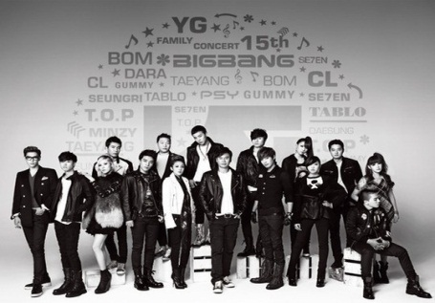
Marketing strategy is essentially the way a company chooses to link its competencies core processes, and other asset to win marketplace battle.
For long time, YGE had struggled to find innovative and profitable business model through visionary marketing strategy. Finally YG & YGE have implemented this successive business & marketing strategy to attract smart-creative people and give them an environment’.
Like Steve Jobs, YG showed distinctive business innovation through merged culture and entertainment business. YGE has showed how to communicate and how to collaborate with fans and stakeholders through social media marketing.
Who is the next?
Everybody will be surprised the next creative artist and musician of YG Entertainment.
‘YG & YGE are pioneers of marketing 4.0’

Slide 24
Thank You
Youngsub Chun,
East Asia Sport Management Institute
www.wheecorea.com
wheeecorea@GMAIL.COM

